Slide 1
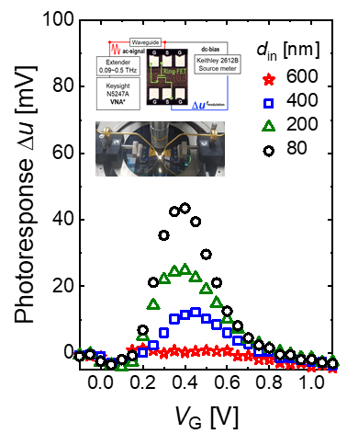
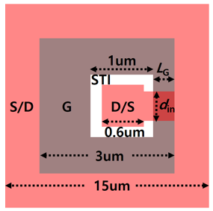
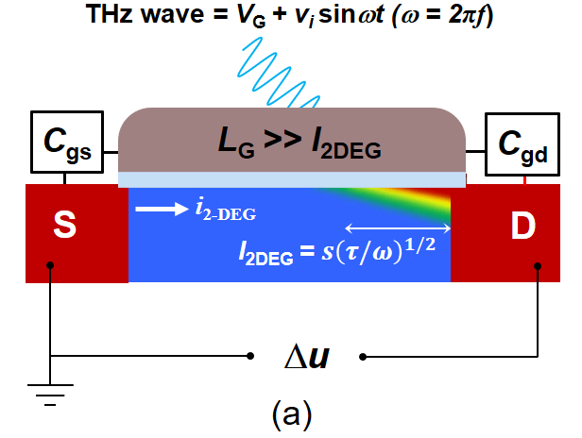
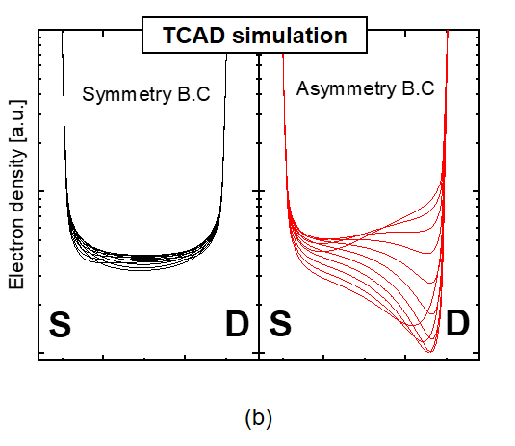
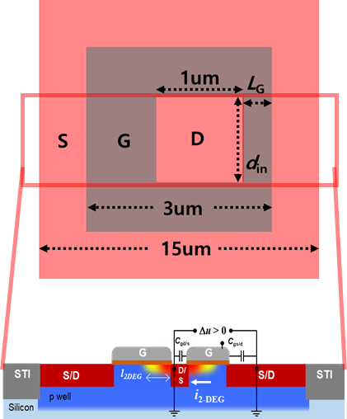
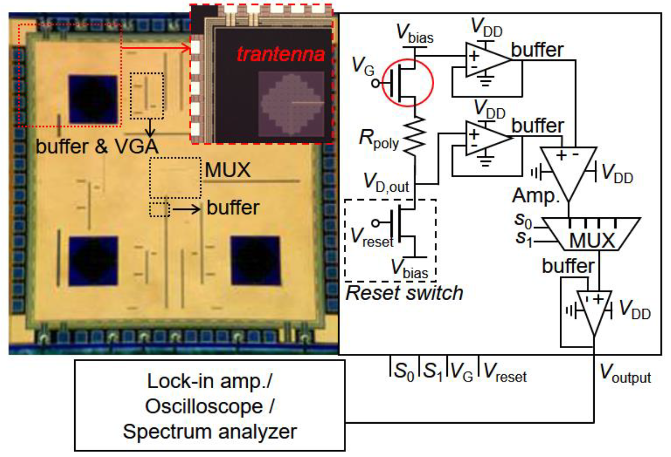
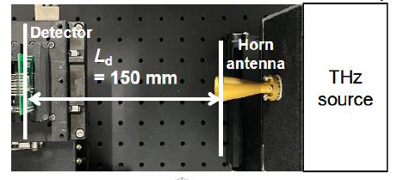
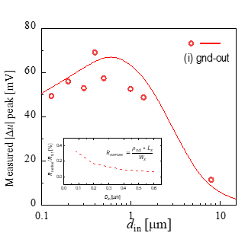
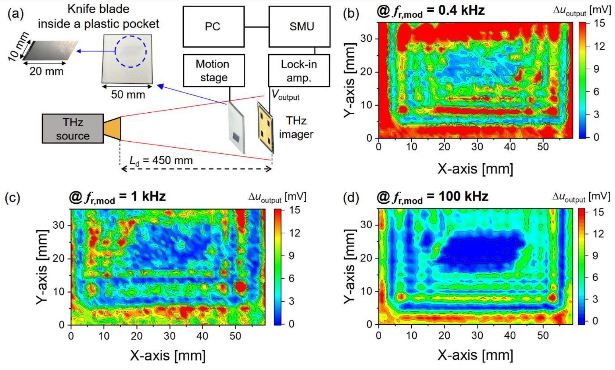
Performance Enhancement of Trantenna by Channel Confined Design Based on 28-nm CMOS Technology
Yoo Bin Song¹, Min Woo Ryu¹ and Kyung Rok Kim^{1*}
¹Department of Electrical Engineering, UNIST, Republic of Korea
Abstract
Performance enhancement
We proposed and verified a channel confined structure with improved performance by analyzing the effect of the contact resistance of the Trantenna device using structural asymmetry.
Based on TCAD simulation, it was confirmed that channel confined structure trantenna can be improved through measurement of actual devices, and imaging was performed through this.
- Channel confined THz detector
Introduction : Plasmonic THz detector
We confirmed that the channel confined structure THz detector improved the performance by reducing the effect of the relative increase in contact resistance caused by the d_{in} scale of the trantenna device.
Enhanced photo-response with asymmetric boundary condition.
Performance enhancement by D_{in} scaling
THz imaging with channel confined detector
It is predicted that the photo-response(Δu) will increase as d_{in} decreases the overlap capacitance and the asymmetric boundary condition improves. However, as the area decreases, the effect of contact resistance becomes relatively large, so it was confirmed that the performance was not improved below d_{in} 400 nm.
Finally, an imaging system was configured to perform blade imaging. The CMOS-based transistor-antenna detector design enables high-speed operation, enabling low-noise and high-resolution imaging.
Acknowledgements
This work was supported in part by the National Research Foundation of Korea (NRF) funded by the Korea government(MSIT) under Grant RS-2024-00351104, NRF-2022R1C1C2008564; The chip fabrication and EDA tool were supported by the IC Design Education Center (IDEC), Korea.
Conclusion
We have experimentally demonstrated the performance enhanced the THz detector with channel confinement
The THz detector with improved photo-response can perform imaging for detecting the hidden object.

